Slide 1
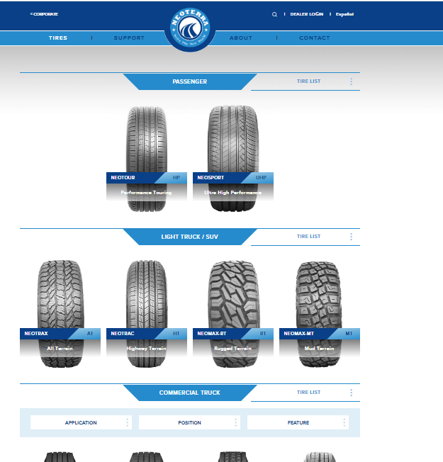
https://www.ketertireusa.com/
https://www.neoterratireusa.com/
Privacy Policy
page
09
00
Homepage(Landing page)
01
02
03
04
ABOUT US
page
NEOTERRA
page
Support page
NEWS (List )
page
NEWS 01
04-1
Cellerate
Page
(when available)
Warranty 01
03-1
NEWS 02
Warranty 02
03-2
Product list
（Template）
NEWS …
05
06
Product Info
(Template)

